Slide 1
Reading Strategies GLA, Part 1

Slide 2
Agenda
This workshop will provide you with active reading strategies that will help you stay engaged and comprehend readings better.
We will cover the following strategies:
Think Aloud
Talk to the Text
SQ3R: Survey, Question, Read, Recite, Review
Look-away method

Slide 3
What is active reading?
Active reading occurs when we read with purpose. In other words, our goal is to learn the material (not just finish the pages) and connect that material to our needs.
We know that we’re reading actively when we are:
Interacting with the reading (previewing the material, taking notes, predicting, etc.)
Critically thinking about the author’s ideas
Considering our own ideas as we read
Notes:
http://www2.open.ac.uk/students/skillsforstudy/active-reading.php

Slide 4
Why should students read actively?
When students read actively, they…
Are better prepared for college-level work
Retain information longer
Find it easier to use/review the information
Use their time well and avoid the reading coma

Slide 5
How should students prepare themselves to read?
We can’t read actively if we aren’t prepared to read.
To prepare, students should…
Find a place they can concentrate
Attend to physical needs (sleep, eat, etc.)
Know why they’re reading
What is the instructor’s purpose for assigning the text?
What is your purpose for reading the text?
Have note-taking materials
* See Pre-reading and Annotation workshops for more details.

Slide 6
Active Reading Strategies
Once you are prepared to read, there are many different strategies you can employ. You will learn about some of those strategies in this workshop.

Slide 7
Strategy 1: Think Aloud

Slide 8
What is the Think Aloud?
The Think Aloud strategy allows students to hear other readers’ strategies and practice some of their own strategies out loud.
To complete a Think Aloud, read a passage out loud. As you read, explain how you are figuring out what the passage means.

Slide 9

Why do a Think Aloud?
Often, when we want to learn something new, we watch someone who already knows how to complete the activity. For example, if we want to learn how to change the oil in a car, we watch someone who knows how to change the oil.
However, if we watch an experienced reader read, this is all we see:

Slide 10
Silent Strategies Audible
By completing a Think Aloud, we make our normally-silent strategies audible. We can hear how other readers approach a text, and share our own strategies with other readers.

Slide 11
Common Strategies
In a moment, you will see a short video that provides an example of a Think Aloud. Before watching the video, though, you should know some common strategies that experienced readers use:
Preview the text to note title, headings, subheadings, and illustrations.
Make connections to the text with prior knowledge and experience.
Create a list, image, or picture of the text, either mentally or on paper.
Confront unfamiliar vocabulary using context clues and root words.
Come back to the text when drifting.
Tolerate ambiguity. (Be willing to read on even if text isn’t perfectly clear yet.)
Reread sections to clear up confusion. (Know when to reread or when to move on.)
Predict what is to come in the text.
Question the author.
Summarize or paraphrase material in own words.

Slide 12
Helpful Phrases
In addition to using the common strategies on the previous slide, experienced readers also use some helpful phrases to understand a text. These phrases are:
I predict that…
I can picture…
A question I have is…
This is like…
This reminds me of…
I am confused about…
I will reread this…
The big idea here is…
I think/believe/wonder…
The author wants me to…
The author’s biases are…

Slide 13
Sample Think Aloud
Click here to watch a short video that shows a Think Aloud.
As you watch the video, make note of the strategies and phrases that the reader is using. Write your answers in your handout.
Use the list of strategies and phrases in your handout to help you.
Notes:
Sociology chapter on deviance: http://freebooks.uvu.edu/SOC1010/index.php/08.html

Slide 14
Strategy 2: Talk to the Text

Slide 15
What is Talking to the Text?
Talking to the Text is very similar to a Think Aloud. Instead of speaking out loud, you will practice your common reading strategies in writing on a text.
This exercise is called Talking to the Text because you have an unspoken conversation with the reading.

Slide 16
How do I talk to the text?
There are several steps you can take to talk to the text effectively.
Use the common reading strategies and helpful phrases that we practiced in the Think Aloud.
Make connections between the reading and information you already know.
Make predictions about where the reading may be going.
Make note of unfamiliar vocabulary and any other questions you may have.
Annotate your text thoroughly (consider attending the Annotation Workshop for more information).

Slide 17
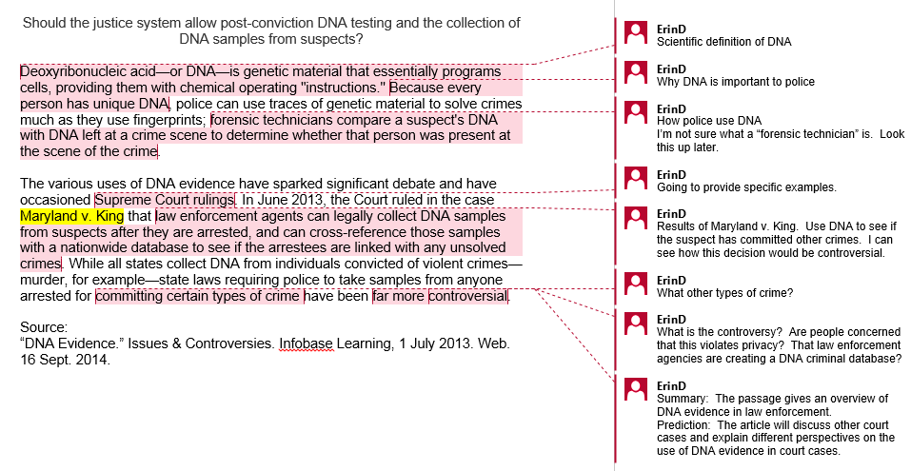
Sample Talk to the Text

Slide 18
Practice Talk to the Text
Complete a Talk to the Text on your own
In your handout, find Reading A (page 3).
Read the passage, making frequent notes. Be sure to consider:
Common reading strategies and helpful phrases
Connections to information you already know
Predictions of where the text is going
Unfamiliar vocabulary/questions

Slide 19
Strategy 3: SQ3R: Survey, Question, Read, Recite, Review

Slide 20
What is SQ3R?
SQ3R is an acronym to help you remember the following reading strategy:
Survey
Question
Read
Recite
Review
We’ll look at each step separately.

Slide 21
Survey
Before you begin reading, survey the text. This means you should flip through the text, making note of:
The title, headings, and subheadings
Captions under pictures, charts, graphs, or maps
Review questions in the text or study guides made by the teacher
Introduction and Conclusion paragraphs
Chapter summary
This will help you make strong predictions about the reading. It will also help you stay focused and engaged.
For more information on surveying a text, consider taking the Pre-Reading workshop.

Slide 22
Question
As you survey the text, ask questions.
Ask yourself, “what do I already know about this topic?’
Ask yourself, “what did my instructor say about this reading when it was assigned?”
Turn the title, headings, and subheadings into questions
Read any review questions that appear in the text

Slide 23
Read
After surveying and questioning, begin reading the text. While reading, you should:
Look for the answers to the questions you created
Answer the review questions in the text
Reread captions under pictures, graphs, etc.
Note any words or phrases in bold or italics
Study any graphic aids
Slow down for difficult passages
Reread passages that aren’t clear

Slide 24
Recite
After each section, stop and recite what you’ve learned. You should:
Summarize the text out loud
Write notes about the reading in your own words
Underline or highlight important points
Reciting requires you to engage in multiple activities (reading, speaking, hearing and writing), which will help you remember the information better.

Slide 25
Review
Review should take place frequently after you have completed a reading to ensure that you remember the information. When you review, you should:
Ask and answer questions about the important points that you identified
Reread the notes you wrote about the text
Make flash cards to help memorize difficult concepts
Create your own study guide for the chapter
Review the study guide to prepare for an exam

Slide 26
Sample SQ3R
Let’s do a sample SQ3R using CDC’s “College Health and Safety” Website. Page 4 of your handout will show you how to Survey, Question, Read, Recite, and Review when studying this website.

Slide 27
Strategy 4: The Look-Away Method

Slide 28
The Look-Away Method
The Look-Away Method asks you to test yourself as you complete a reading. Periodically, look away from the reading to ask yourself questions about the material. You should:
Briefly summarize the material
Ask and answer sample test questions about the material
Respond to the material: Do you agree or disagree? Why?
Make connections to the material: How does it relate to what you already know? To your assignment? Your major? Your career?
As you complete the above steps, write notes for yourself in the margins or in your notebook. This will help you remember the material better.

Slide 29
Sample Look-Away
When you are done reading the passage, do a sample Look-Away using at least one of the below strategies. Write your answer in the handout (page 5).
Look-Away Strategies:
Briefly summarize the material
Ask and answer sample test questions about the material
Respond to the material: Do you agree or disagree? Why?
Make connections to the material: How does it relate to what you already know? To your assignment? Your major? Your career?
Instructions: Read the below passage from an art history textbook.
Cambodia: Angkor Wat and Angkor Thom
“Angkor Wat (a wat is a Buddhist monastery) was originally a Hindu temple built between 1113 and 1150. Dedicated to Vishnu by its builder, King Suryavarman II, it is a physical representation of Hindu cosmology. The five central towers represent the peaks of Mount Meru, the Olympus of the Hindu gods and the center of the universe. The outer wall symbolizes the mountains at the edge of the world; the moat represents the oceans beyond” (488).
Source:
Tansey, Richard and Fred Kleiner. Gardner’s Art Through the Ages. 10th Ed. Fort
Worth, Harcourt Brace College Publishers, 1996.

Slide 30
Conclusion
This workshop covered several reading strategies that should help you read more effectively. These strategies are:
Think Aloud
Talk to the Text
SQ3R: Survey, Question, Read, Recite, Review
Look-away method
As you move forward, consider the strategies that work best for you and employ them as you read. You do not have to use all four strategies at once; instead, select the methods that work best for you.

Slide 31

If you liked this lesson and would like more information, consider attending:
Pre-Reading
Annotation
Online Research
Why should you come back?
Students completing Supplemental Learning Activities had a 10% higher success rate across the disciplines, a 21% higher success rate in Math, and a 49% higher success rate in English courses.

